Slide 1
ENCORE: ENSEMBLE LEARNING USING CONVOLUTION NEURAL MACHINE TRANSLATION FOR AUTOMATIC PROGRAM REPAIR
T Lutellier, L Pang, VH Pham, M Wei, L Tan
2020-03-19
JuHyoung Kim
kjhkjh75@naver.com

Slide 2
- Past work
Checking CNN performance
Original goal : combination code CNN seq with sequenceR
-> comparison paper
-> consulted by author.

Slide 3
-INTRODUCTION
Existing work applying NMT to repair bugs generally uses the best model
Deepfix
limitations of repairing statements containing more than 15 characters.
SequenceR
worse on the Defects4J benchmark than most G&V techniques.
Even though context is important for fixing bug,
not effective approach for incorporating context to the DL models
Capturing meaningful information on long tokens is difficult.

Slide 4
INTRODUCTION
- Propose G&V technique ENCORE
- G&V methods often programming language dependent
> NMT-based can be trained to fix bugs in different programing languages.

Slide 5
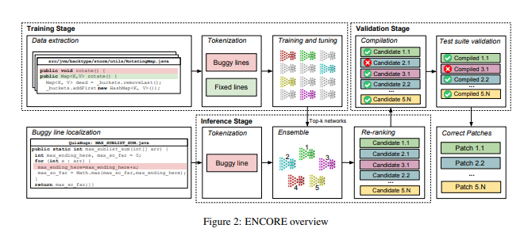
APPROACH

Slide 6
Challenage
- Convolutional layers performs better that capture immediate context information than RNN
- NMT has no access to the entire project due to limit of sequence size,signle model might overfit.
-> ensemble approach with vaildation stage.
- adptability to different programming languages.
- Large vocabulary size

Slide 7
Data Extraction
- "fix","bug","patch"
-> could not enough to filter unrelated commits.
-62/100 pairs were related to real bug fixes.
- "rename","clean up","refactor","merge","misspelling","compiler warning"
->Using these patterns increase the number of correct pairs this models.
- Remove sequence size is than 2 times standard deviation,cosmetic changes
- removes comments and sequence that contain non-utf-8 characters.
- Identical changes with other APR techniques.

Slide 8
Input Representation
- NMT struggle when input sequence contains more than 30 tokens.
-> Adding context to the input significanlty increase size of input.
- Increasing the size of context also has the disadvantages and advantagees.
So Controling this is very important.
Tokenization.
New token CAMLE for camel cases to mark split occurs
String>STRING infrequent number >NUMBER
all abstractions for all tokens can lose semantics.

Slide 9
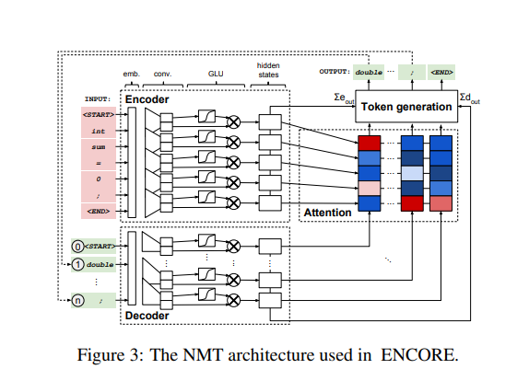
NMT Architecture

Slide 10
Ensemble Learning
Very divers bugs with different fixing patterns
-> Training an effective generalize model to fix all bug type is difficult
-> easier to overfit models to fix specific types of bugs.
Combines models with different hyper-parameters(different networks)
Use beam search to generate the top-k patches for each model,
and use negative log likelihood to rank the output.

Slide 11
Patch Validation
Statement Reconstruction.
Inversion of the tokenization step.
<STRING><NUMBER> extract candidate numbers and string.
If there are not exist, discard.
Compilation and Test Suite Validation.
Use a validation step to filter out patches that do not compile or do not pass test cases.
Multiple bugs in one projects and several test cases might fail because of another bug.
-> Test cases that make the buggy version pass should still pass
-> Test cases that that failed on the version fixed by
developers can still fail.

Slide 12
Evaluation.
Defects4J and QuixBugs in java
QuixBugs in Python.
C++
Javascript.
Use the implementations of LSTM,Transformer, FConv

Slide 13
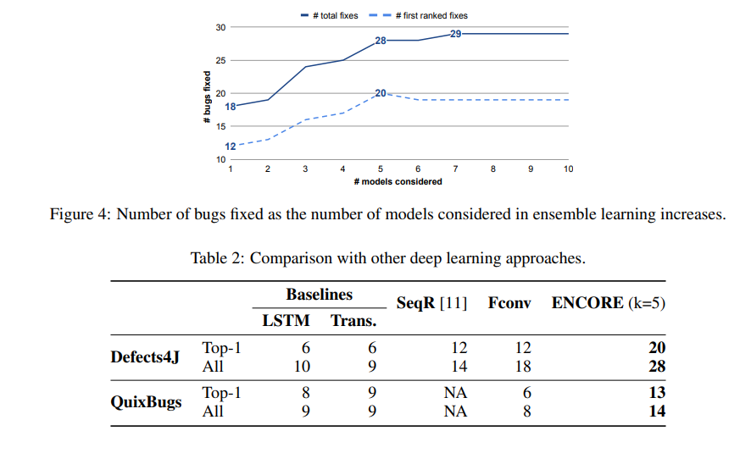
RQ
Comparison with state-of-the-art NMT models

Slide 14
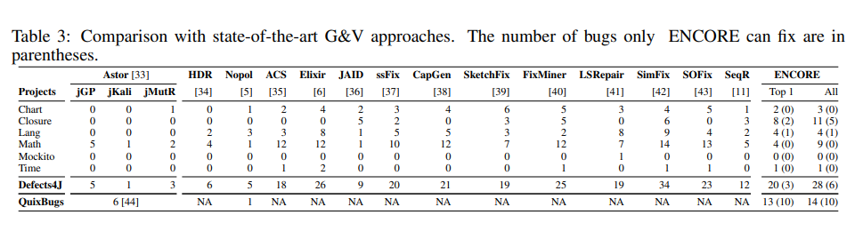
RQ
ENCORE performed 25 different types of action
Performs 1.8actions per bug, SequenceR 1.2actions.

Slide 15
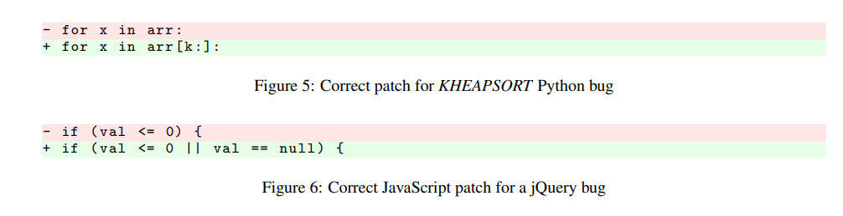
RQ
Apply model to 3 popular programming languages
1)Python
2)C++
3)JavaScript
ENCORE is the first approach that has been successfully applied without major re-implementation to different languages, fixing a total of 67 bugs in four popular programming languages.

Slide 16
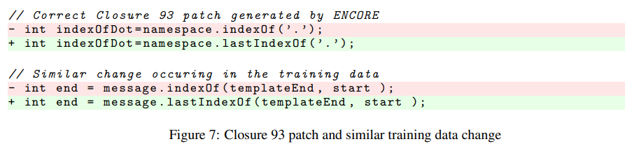
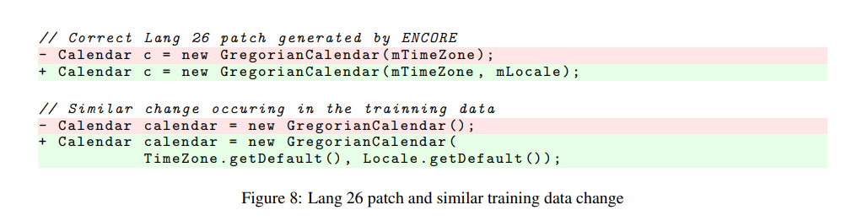
RQ

Slide 17
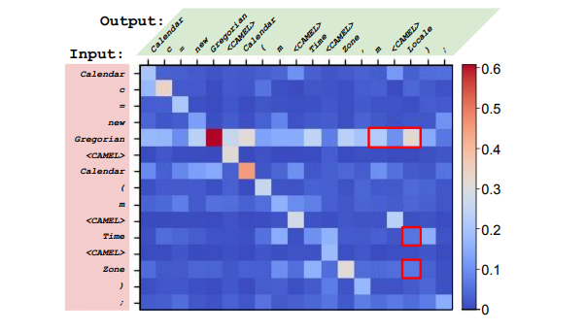
RQ

Slide 18
Limitation
Randomness of deep learning model
Buggy line localization is needed.

Slide 19
Reply
- There are papers that uses CNN
- Using graph neural network is also promising.

Slide 20
Conclusion.
Constant long context
Fit model can be different.

